Slide 1

Car Rental System
21104009 Aashay Ingale
21104049 Akshit Lokhande
21104046 Prasidh Kunder
Project Guide
Ms. Rujata Chaudhari

Slide 2
Contents
Introduction
Objectives
Scope
Features / Functionality
Project Outcomes
Technology Stack
Block Diagram if applicable

Slide 3
1. Introduction
A car rental system is a process or service that allows individuals or businesses to rent vehicles for a certain period of time.
Problem Identified :
Customers may have limited options for transportation, particularly in areas with limited public transportation. This can make it difficult.
Relying on public transportation can be inconvenient and time-consuming, particularly for customers who need to travel outside.
Solution Proposed :
Customers can select the type of vehicle they want to rent based on their needs and preferences.
Car rental system is convenient and saves time
Users can easily search for available rental vehicles, select the vehicle that meets their budget

Slide 4
2. Objectives
To Provide customers with reliable, efficient, and cost-effective transportation services.
To implement well-maintained, clean, and up-to-date which provide customers with a safe and enjoyable driving experience.
To provide a high level of customer service and offering flexible rental options,
To offer the best of rates and include the different categories of cars from luxury to budget.

Slide 5
3. Scope
Promoting sustainability: The car rental system promotes sustainability by reducing its carbon footprint, using fuel-efficient vehicles, and implementing environmentally friendly practices in its operations.
Car rental provides you the ease of renting a vehicle and then riding it like you own it with a certain amount of charges.
Car rental helps you save a lot of money. By renting a car from a company, you get to save a lot of money which you would have otherwise wasted on your travel from one end to the other.

Slide 6
4. Feature /Functionality
Customers can view available cars, register, view profile and book car.
A well-designed car rental system can reduce the time to complete transactions.
Availability of car description so that the user can get idea about their ride.

Slide 7
5. Outcome of Project
The project’s goal is to automate vehicle rental and reservation.
Makes it easy for user to login and to get further access.
Available 24/7 so that clients don’t have to waste time calling and waiting for a vehicle.

Slide 8
6. Technology Stack
Python(Tkinter)
Sqlite3

Slide 9
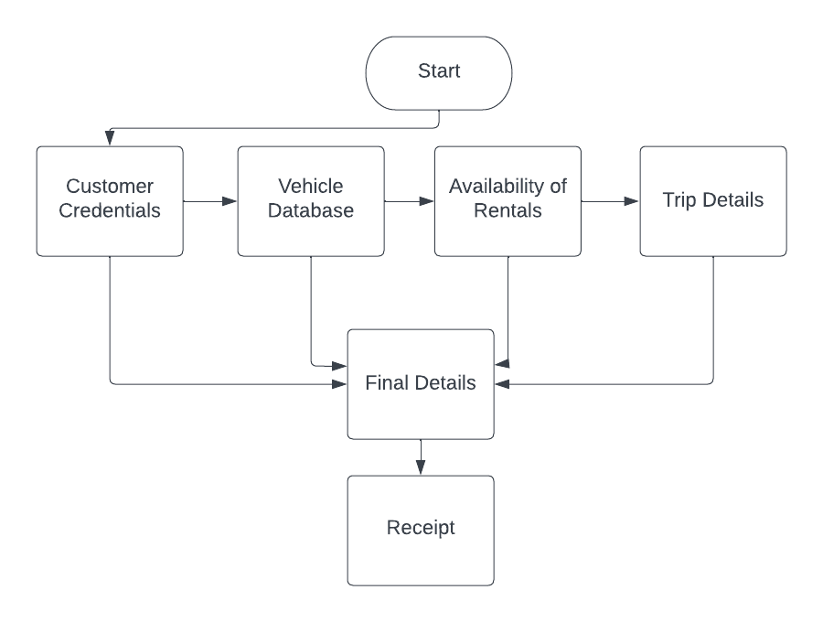
7. Block Diagram

Slide 10
Thank You...!!

